Slide 1
TCP流量控制

Slide 2
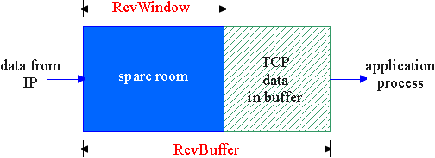
TCP Flow Control
receive side of TCP connection has a receive buffer:
app process may be slow at reading from buffer
flow control
sender won’t overflow
receiver’s buffer by
transmitting too much,
too fast
speed-matching service: matching the send rate to the receiving app’s drain rate

Slide 3
TCP Flow control: how it works
Rcvr advertises spare room by including value of RcvWindow in segments
Sender limits unACKed data to RcvWindow
guarantees receive buffer doesn’t overflow
LastByteSent – LastByteAcked <= RcvWindow
(Suppose TCP receiver discards out-of-order segments)
spare room in buffer
= RcvWindow
= RcvBuffer-[LastByteRcvd - LastByteRead]

Slide 4
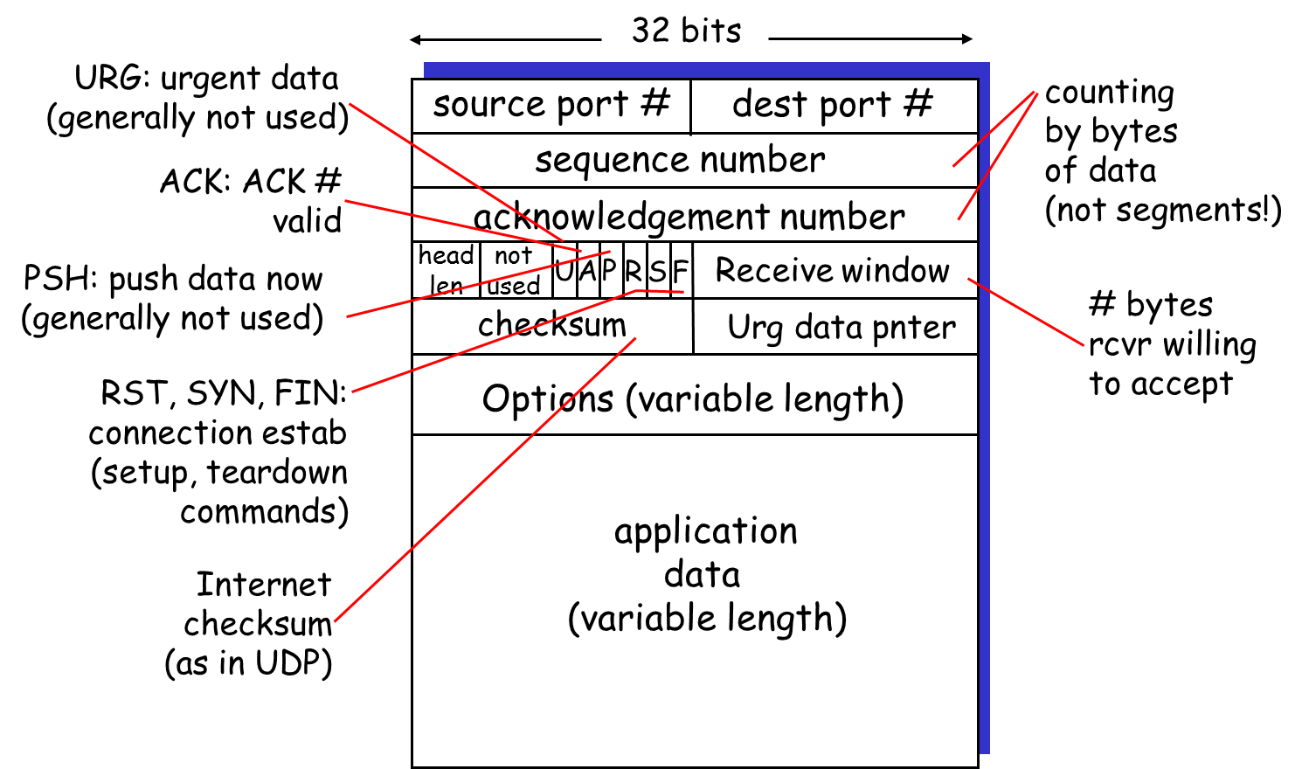
TCP segment structure

Slide 5

Summary
TCP Flow Control

